Slide 1
Better Know a PowerShell UI
Ryan Ephgrave
EphingAdmin.com @EphingPosh
Concurrency

Slide 2
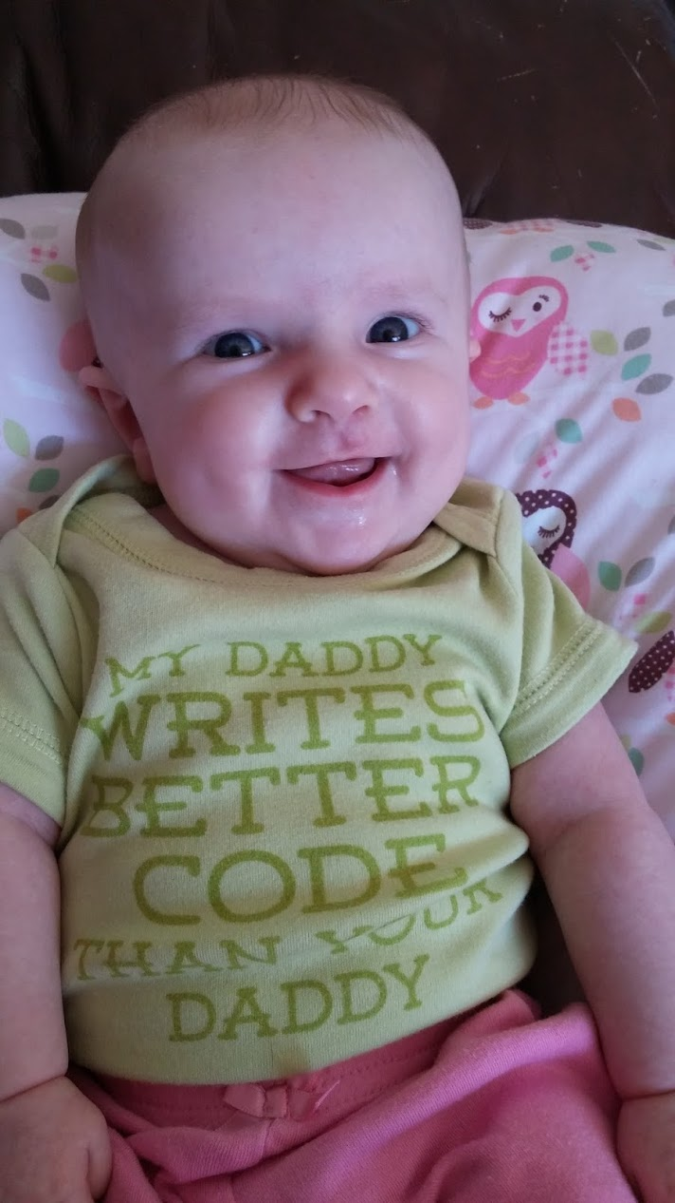
Why should you trust me?

Slide 3
TWITTER – Better Know a PowerShell UI
You can tweet @EphingPosh during the session to have your comment displayed on the screen!
Don’t be “that guy”. Don’t be the one who ruins it and makes me have to turn it off!

Slide 4
Check out my blog!
Most of what I say is on my blog.
http://www.ephingadmin.com/better-know-a-powershell-ui/

Slide 5
Presentation
Just a placeholder slide. Please use the example slides in the “Template Example Slides” Section.
Questions? info@mnscug.org

Slide 6
















And Then …

Slide 7
Section Header
This is the next section

Slide 8
Title
Line1
Line2
Line3
Line4
Line5
Line6
Bullet Level 1
Bullet Level 2
Bullet Level 3

Slide 9
Title
Code

Slide 10
Text Only with Border
Level 1
Level 2
Level 3

Slide 11
Text Only without Border
Level 1
Level 2
Level 3

Slide 12
Title
Text 1
Level 1
Level 2
Level 3
Text 2
Level 1
Level 2
Level 3

Slide 13
Title
Section 1
Section 2
Text
Level 1
Level 2
Level 3
Text
Level 1
Level 2
Level 3

Slide 14
Demo Title

Slide 15





























Slide 16






























Slide 17




























Slide 18




























Slide 19




























Slide 20




























Slide 21




























Slide 22























Slide 23































Slide 24


